Slide 1


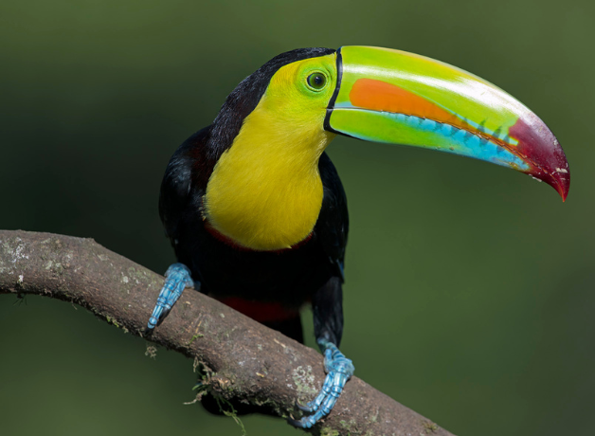
Meet the Teacher
Toucan Class
Year 4 – Miss Marriott

Slide 2
Introductions
Class Teacher: Miss Marriott
PPA Cover: Miss Ashton (Tuesday)
Teaching Assistants: Ms Rawson, Miss Ashton
r

Slide 3
First day
Important dates:
Friday 4th September – Inset Day
Monday 7th September – First day in Year 4
What to bring:
A small school bag or book bag that can either hang on their peg or go in their tray.
A named water bottle.
Their Year 4 Summer Homework booklet (to receive some merits!).
r

Slide 4
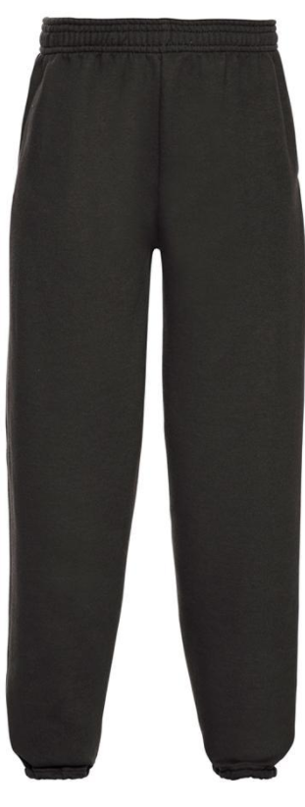
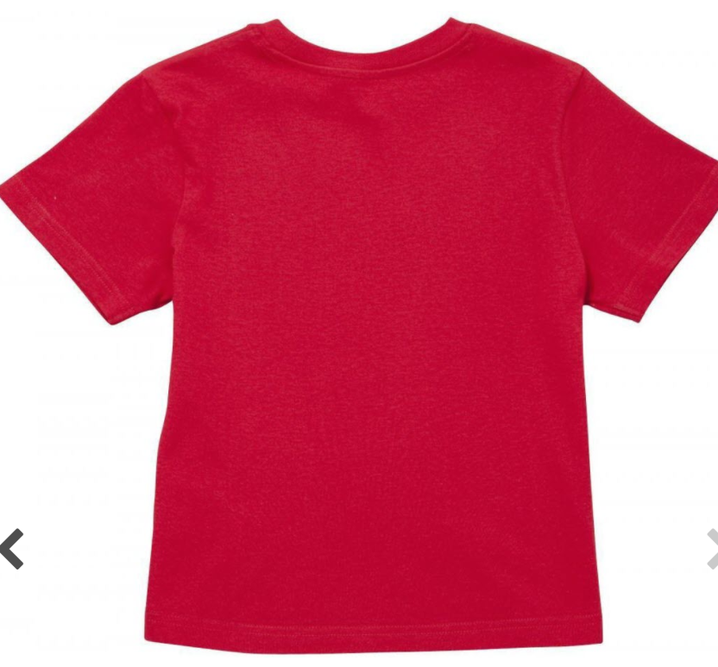
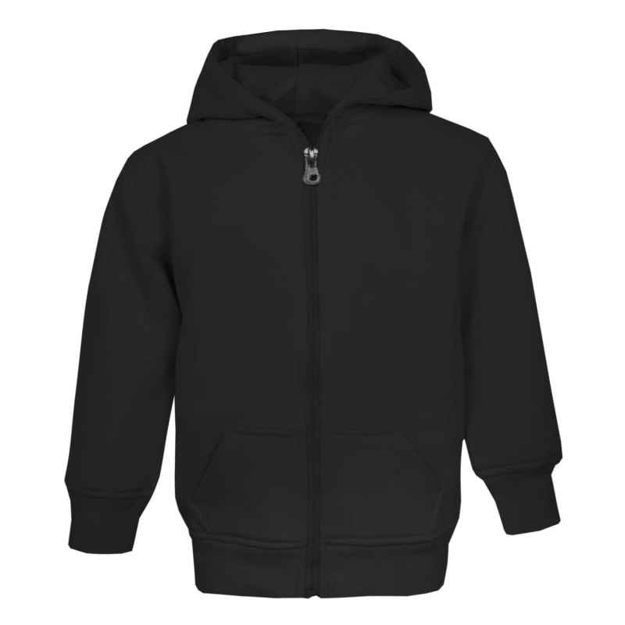
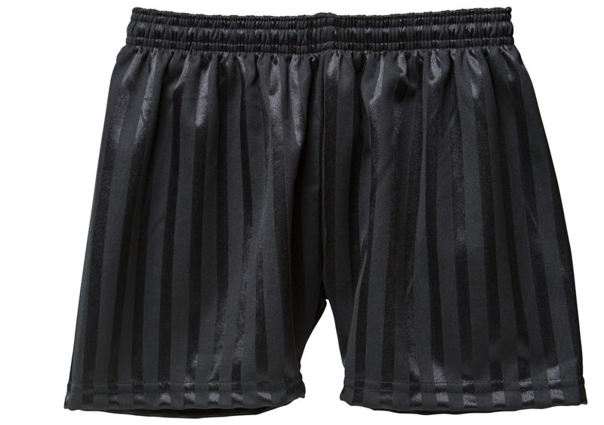
PE Kit
Indoor:
Outdoor:
r
A red t shirt, black shorts, joggers or leggings and a black sports type hoodie/jacket.
All should be picture free except for the school logo where applicable.

Slide 5
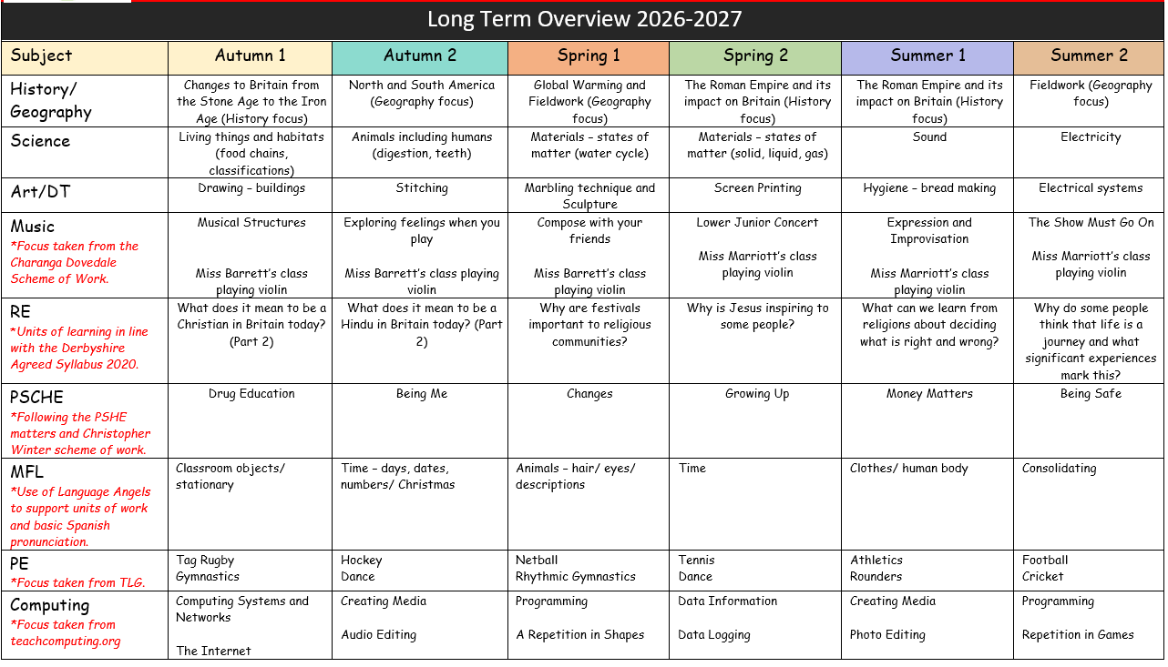
Learning Overview
This is a broad overview of the learning this year.
Each half term, we will provide more details about our learning on the Class Webpage.
r

Slide 6
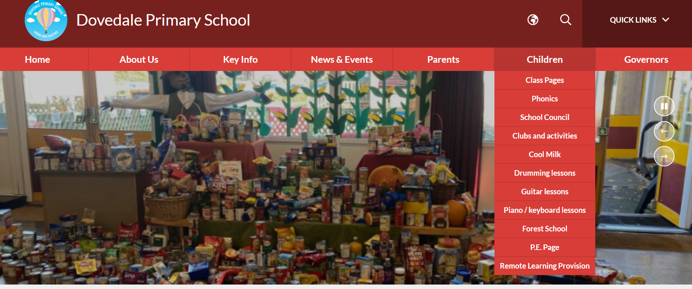
Class Page
r

Slide 7
Autumn Term 1
English – Descriptive Writing, Speech and Narrative Writing
Maths –Place Value, Addition and Subtraction
Science – Living Things and Habitats
History – Changes to Britain from the Stone Age to the Iron Age
PSCHE – Drug Education
RE – What does it mean to be a Christian in Britain today?
Art – Drawing (Buildings)
Computing – Computer Systems and Networks
PE – Gymnastics and Tag Rugby
Spanish – Classroom Objects/Stationary
Music – Violin lessons (September till February)
r

Slide 8
Homework
Reading – Please read 3 times to an adult at home to receive a merit and be part of the reading raffle draw.
Spellings – These will be set weekly to learn and will be available on Spelling Shed to practice.
Times Tables – We ask the children to be learning their times tables each week. This can be however works best for you including on TT Rockstars.
Weekly online task – This will either by a My Maths task, a Spag.com task or a TT Rockstars battle (3 week cycle).
r

Slide 9
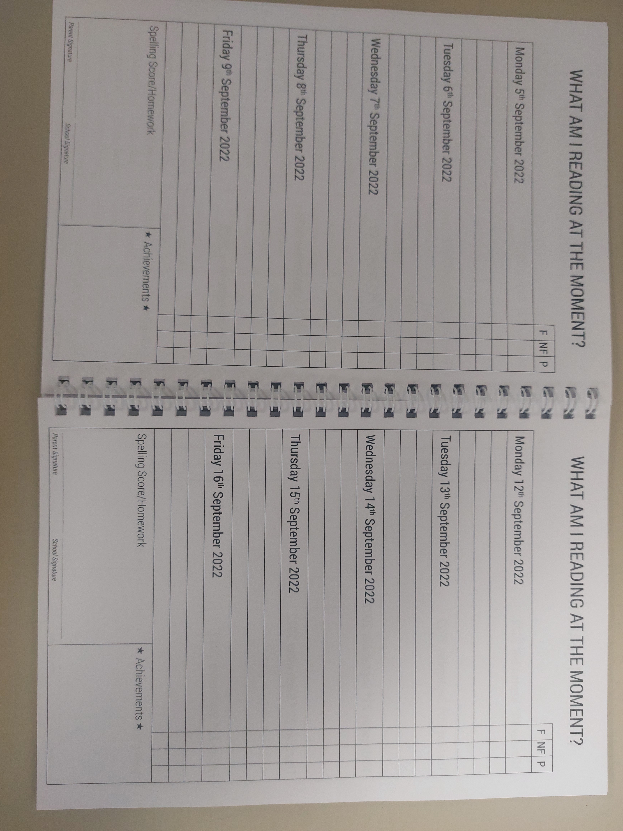
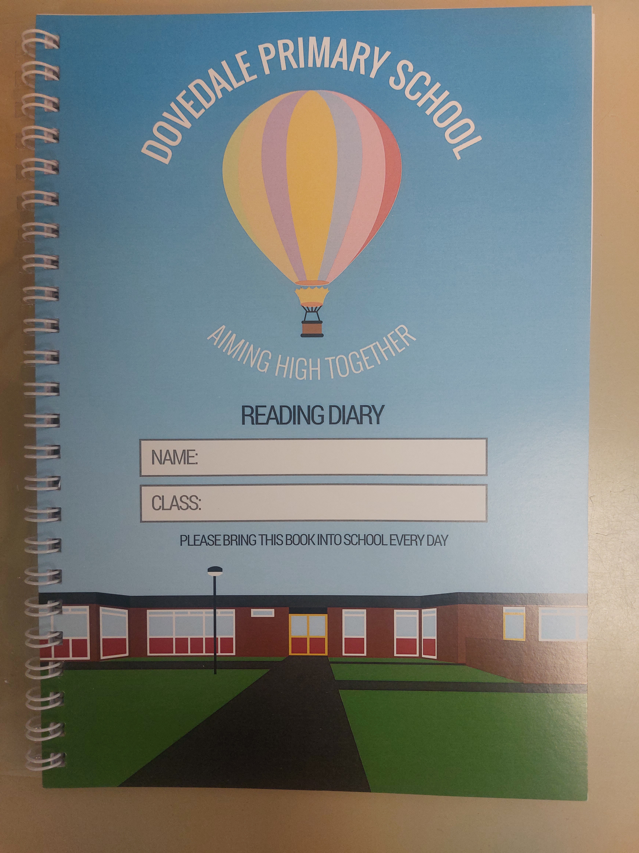
pl
Reading Diaries
Add title of book and page number as well as signature.
x3 a week for stamp in achievements.
Please add a * next to your writing.
Please tick if fiction (F), non-fiction (NF) or poetry (P)
r
Homework slips will be placed here

Slide 10
Times Tables
It is really important that the children are learning their times tables.
In Year 4 the children will take a government set multiplication check in the summer term.
The check is completed on a computer or an iPad in school. The children are given 25 random multiplication questions and they will have 6 seconds to answer each question.
The TT Rockstars Sound Check mode is very similar to the government check set up.
r

Slide 11
Rewards
Merit Charts and Class Dojo
Table group winner
Behaviour Ladder
House Points
Star of the Day
Star of the week – REACH award
r

Slide 12
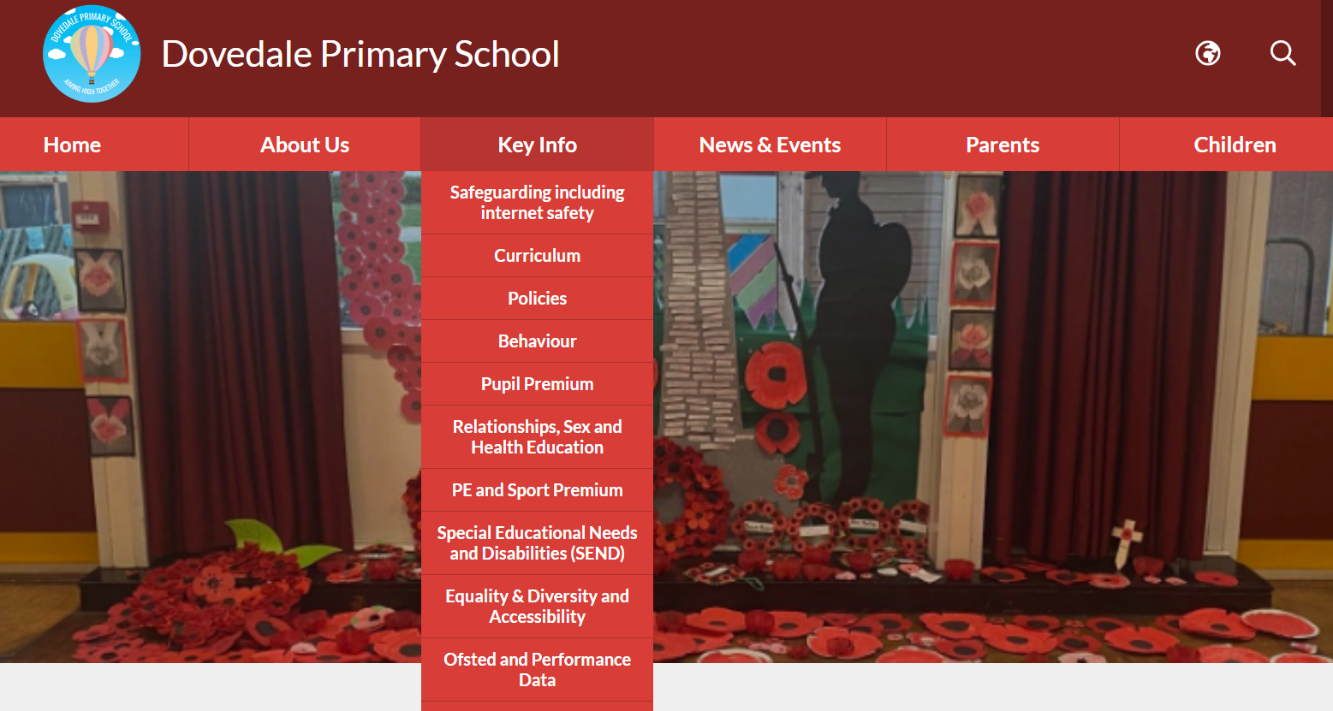
Key Information
r

Slide 13
Keep in Touch
Class Dojo – Updates, reminders and photos will be uploaded on here.
Class Webpage – Please check our class webpage for information regarding the curriculum, homework, spellings and key dates. I will also complete a class blog to detail the exciting things we get up to as a class!
Email - cmarriott@dovedale.derbyshire.sch.uk
r

