Slide 1



Meet the Teacher
Welcome to Year 6!

Slide 2
Staffing:
Mrs Kelly - full time. PPA every other Friday, covered by Miss Berrington.
Wednesday afternoon -SENDCo time.
TAs - Mrs Mulnier & Miss Austen.
Partner Class - Mr McCarthy.
r

Slide 3
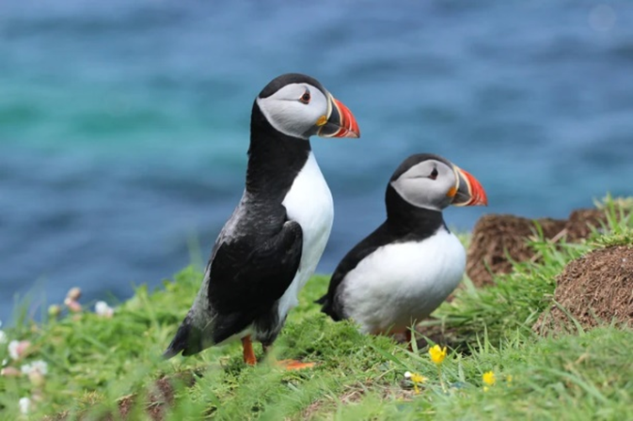
Puffin Class.
(Bird theme).

Slide 4
Expectations:
Final year - role models
Arrive on time and ready to learn - attendance so important!
Willingness to step out of comfort zone
Be the best versions of themselves
Independence & self management

Slide 5
SATs
Very low key approach
Ensure the children are well prepared
Mental health support
Children doing their best
Relaxed, supportive approach
Children knowing their strengths and where they need to improve - ongoing throughout year.

Slide 6
Autumn Term 1
Assessments
Key skills for English and Maths
History - Maya Knowledge block
PSHE - Being me.
RE - What is it like being a Muslim and living in Britain today?
PE - Rugby & Street Dance.
SCIENCE - Living things.
ART: Sculpture - clay
English - Percy Jackson and the Lightning Thief.
r

Slide 7
Homework (book or online)
Reading at home – Read 3 times to an adult receive a merit & entered into reading raffle.
Spellings will be set weekly: tested on Fridays.
Times table practise - vital TT Rockstars.
Piece of maths or English each week - can be paper based or online.
Homework books to stick homework into.
r

Slide 8
Residential.
Usually in late June/early July.
PGL Caythorpe.
Time to relax and have fun after all of our hard work!
Deposit payable in September.
Payment plan - chip away at the final balance.
Optional.
Fundraising for the coach - £1 challenge.
r

Slide 9
Rewards
Behaviour ladder
Celebration assemblies - linked to REACH values.
Merit charts
House Points
Special person certificates.
r

Slide 10
Keep in touch
Class page on the school website.
Link up to Class Dojo for messages and to read our class story
My email: ekelly@dovedale.derbyshire.sch.uk
r

Slide 11






Our Values

Slide 12
Our Values
espect
njoyment
chievement
r
hallenge
ealth

