Slide 1
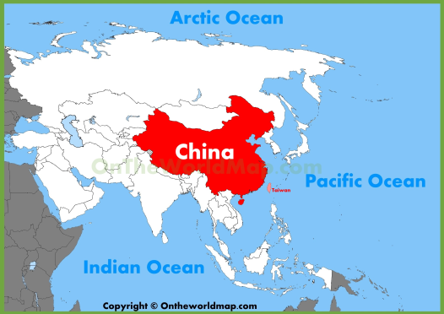
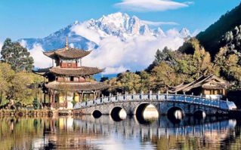

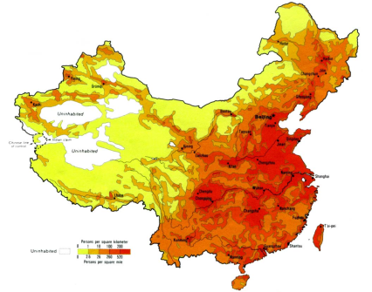
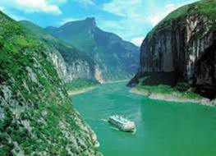
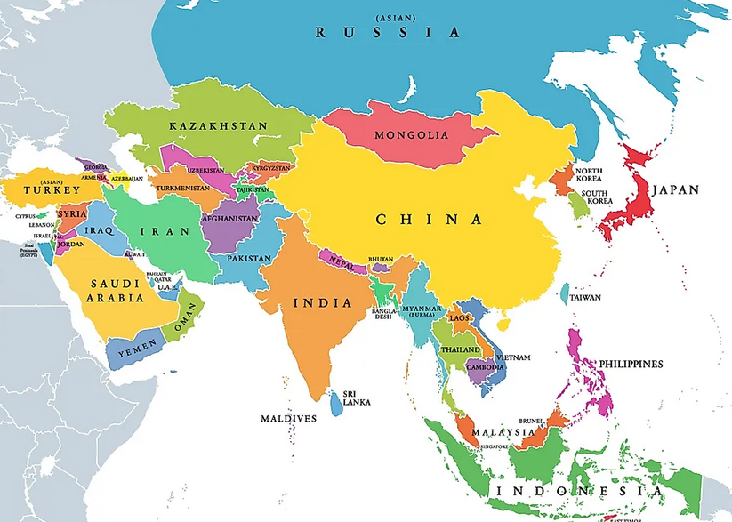
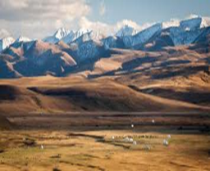
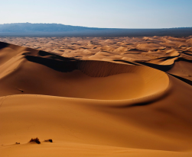
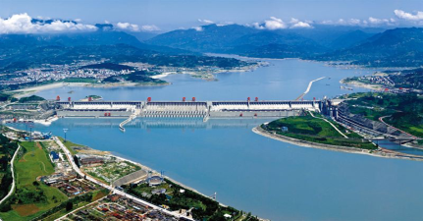
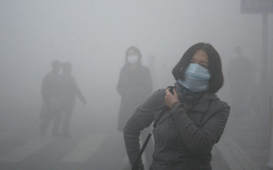
Year 6: Asia and China
Pollution is very high in China
Causes
Burning coal for electricity
Factories emit greenhouse gases
Traffic – people are getting richer so they have more cars
Sewage – 90% of human waste flows into China’s rivers
Impacts
Global warming and climate change
The particles in the air can cause asthma and other respiratory diseases
Water pollution kills fish and makes the water undrinkable for people
Air pollution can cause acid rain and destroy crops
Total cost of pollution in 2013 estimated to be 10% of China’s GDP.
Population density = the amount of people living in an area
China is densely populated on its east coast where a lot of cities are.
China is sparsely populated in the west, particularly around the Tibetan Plateau
Location
Human geography
Northern Hemisphere
East Asia
Nearby countries: Russia, Vietnam, India, Nepal, North and South Korea
Nearby seas: East China Sea and South China Sea
Capital city: Beijing
Largest city: Shanghai
Population: 1.3 billion people – the largest in the world
Physical geography
Yangtze River
Longest river in China (3rd longest in the world)
Stretches for 6,300km from the Himalayas in West China to Shanghai on the east coast
Flows into East China Sea
Famous for 3 Gorges Dam
3 Gorges Dam
China has a climate that varies dramatically over the different areas
Positives
Provide clean energy
Provide hundreds of jobs
Reduce flooding downstream
Negatives
1.2 million people had to leave their homes to make way for it
The Yangtze river has dropped to its lowest ever level
It will block essential nutrients and fish travelling downstream.
Tibetan Plateau
An elevated area of land in Central and East Asia
Located in between the Himalaya Mountains and the Taklimakan Desert
Known as the ‘roof of the world’
Near the tallest mountain in the world, Mount Everest
Non-renewable energy = Energy sources that will run out one day, e.g. coal and oil
Renewable energy = Energy sources that will never run out, e.g. wind, solar and hydro-electric power
Gobi Desert
Covers northern China and southern Mongolia.
It is the fifth largest desert in the world.
A cold desert where temperatures range between 25ºC in summer and -30ºC in winter.

