Slide 1



Meet the Teacher
Welcome to Year 2
Amethyst Class

Slide 2
Introductions
Welcome to Amethyst class. I am Mrs Ganguly and I will be your child’s class teacher.
Ms Musson, Mrs Salt and Ms Haywood will also be there to support your children in class this year.
My PPA day will be on a Thursday once every fortnight and Mrs Robinson will be covering my class.
Weekly timetable:
We will have indoor PE and outdoor PE sessions every week. We will notify you the exact days at the beginning of September.

Slide 3
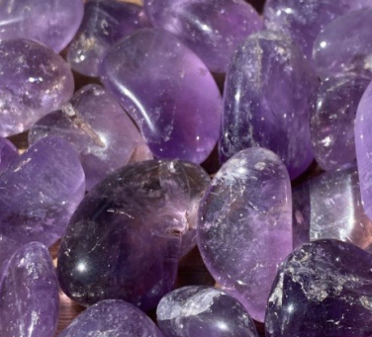
Amethyst class
This year we have chosen different gems as our class names
The Amethyst gem symbolises spirituality, peace, and intuition. Historically, it has been associated with protection, healing, and enhancing psychic abilities. It is also linked to emotional balance, wisdom, and spiritual growth.
Notes:
JESS

Slide 4
Please drop your child off at the side gate before school at 8.45am.
We will bring the class out of our front door at 3.20pm. If there are any changes, we will let you know.
r
Notes:
JESS

Slide 5
What your child needs to bring to school:
Named water bottle
Reading book/s and diary
Packed lunch if needed
Come to school wearing PE kit (days TBC)
Forest school – children will need suitable clothing and footwear. (Term-TBC)
r
Notes:
JESS

Slide 6
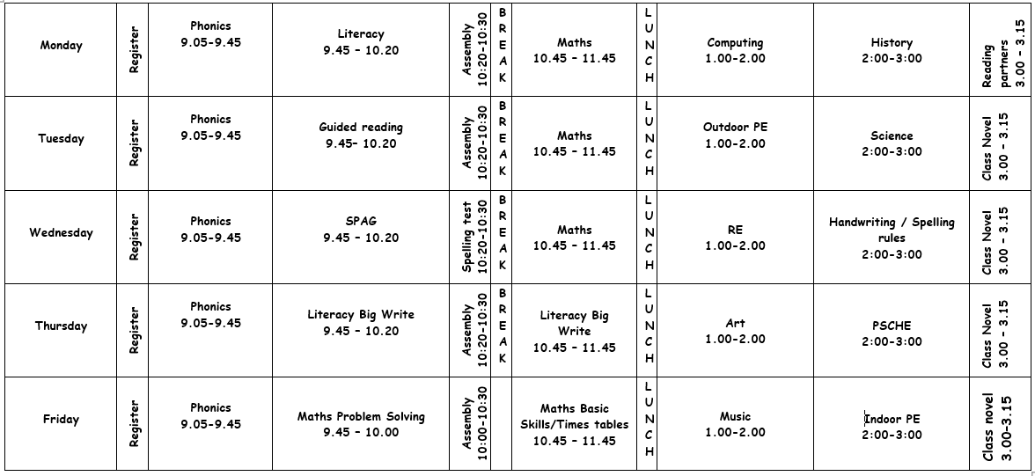
Our Timetable – an example!
r
Notes:
JESS
Start with the history of the local area – looking at places such as West Park and Long Eaton.
Look at significant people including Roald Dahl, Florence Nightingale, Samuel Pepys.
And also significant events such as the moon landing, The Great Fire of London, The Gunpowder Plot.
SATS – May – no holidays please!
Children are prepared and ready.

Slide 7
Our Timetable
We will upload the Autumn 1 timetable on the class page in September.
Important messages and curriculum information will be sent on class dojo and uploaded on the class page.
I will show you how to navigate to my current class page.
Notes:
JESS
Start with the history of the local area – looking at places such as West Park and Long Eaton.
Look at significant people including Roald Dahl, Florence Nightingale, Samuel Pepys.
And also significant events such as the moon landing, The Great Fire of London, The Gunpowder Plot.
SATS – May – no holidays please!
Children are prepared and ready.

Slide 8
Autumn Topic
Our Curriculum
Literacy – Basic skills with a focus on our class novel, Charlie and the Chocolate Factory by Roald Dahl.
Maths – Basic skills with a focus on place value.
Science – Animals including humans block.
PSCHE – Health and well-being: Growing Up
RE – Believing: Who is a Christian and what do they believe?
DT & Art – Drawing
Music – Hands, Feet, Heart – African music
History & Geography – The Great Fire of London.
Computing – Digital Footprint / Being Kind Online.

Slide 9
Homework
We encourage children to read at home with a grown up and it will be really good to have a discussion about it with them after. This should be done at least 3 times a week and recorded in their reading diaries.
My Maths – Set fortnightly on a Friday
Timestables- 2,5,10 timestables
SPAG.com - introduced fortnightly after Christmas
Spelling Tests – Weekly (probably Mondays- TBC)

Slide 10



Reading
Read Write Inc phonetically decodable books
‘Storybook’ + ‘Book bag book’
Plus a book to share at home
r
Notes:
LOUISE
When your child reaches Turquoise level books, they will progress onto Accelerated Reader.
If you are not familiar with Accelerated Reader, we will give you further information when your child is ready to start using it.
Spelling list sent home at the beginning of term. Test is on Wednesdays.

Slide 11
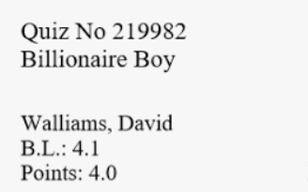

Reading
When phonics is secure, children progress to read books on Accelerated Reader
r
Notes:
LOUISE
When your child reaches Turquoise level books, they will progress onto Accelerated Reader.
If you are not familiar with Accelerated Reader, we will give you further information when your child is ready to start using it.
Spelling list sent home at the beginning of term. Test is on Wednesdays.

Slide 12







Our Values
Notes:
LOUISE

Slide 13
Our Values
espect
njoyment
chievement
r
hallenge
ealth
Notes:
LOUISE

Slide 14
Rewards
Behaviour ladder
Sticker cards
House Points
Star of the week
Leaf on the Achievement tree
Table of the week
Star writer of the week
r
Notes:
LOUISE

Slide 15
Our KS1 school trip will be sometime in the year and will be confirmed at the start of the new academic year.
The cost will be no more than £20.
We will be also be raising some money for this from our Christmas Concert.
r
Notes:
LOUISE

Slide 16
Keep in touch
Please look at our class page on the school website for regular updates.
Link up to Class Dojo for messages plus our class story.
Email:
sganguly@dovedale.derbyshire.sch.uk
I am looking forward to seeing you in September.
r
Notes:
JESS

Slide 17
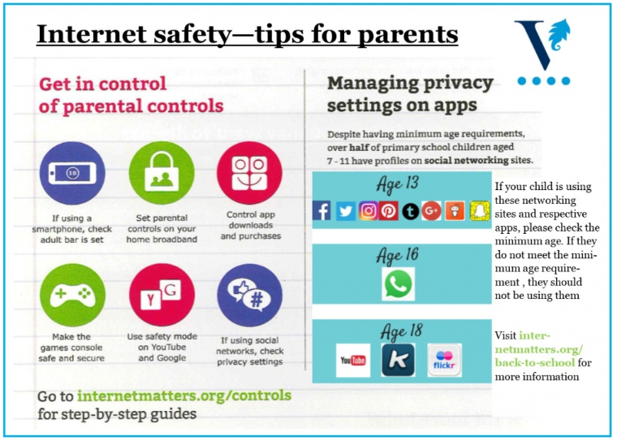
r
Notes:
JESS

Slide 18

r
Notes:
JESS

