Slide 1


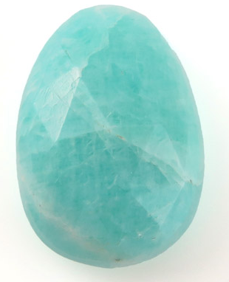
Meet the Teacher
Amazonite Class
Year 2 – Miss Bestwick

Slide 2
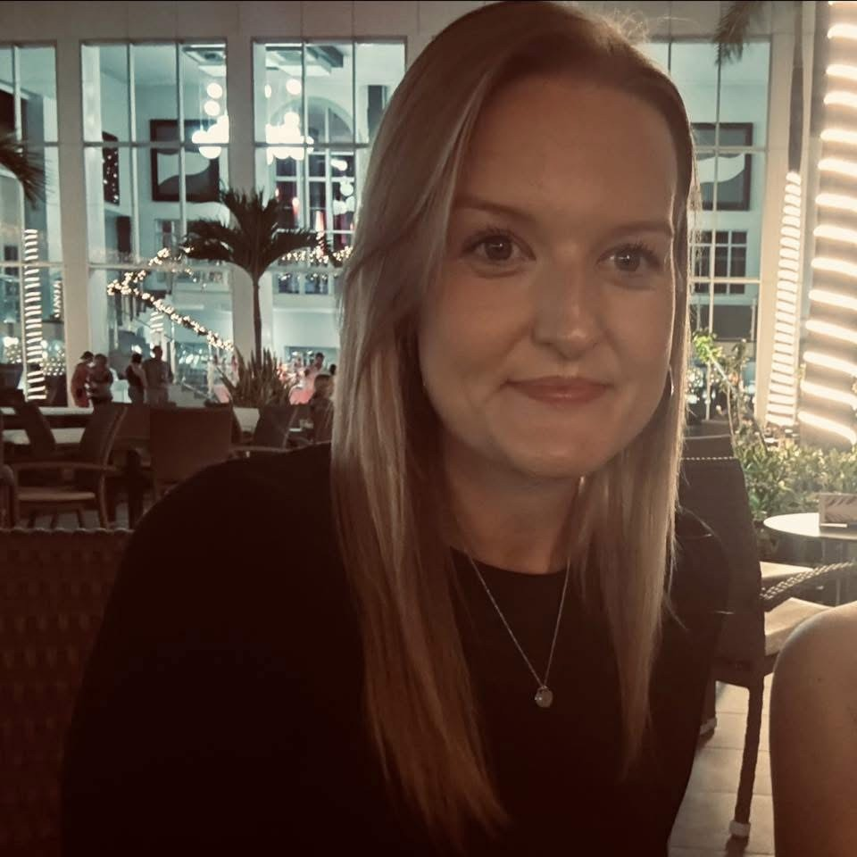
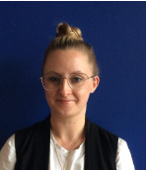
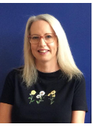

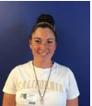
Introductions
Miss Bestwick
Mrs Robinson
Class teacher
PPA teacher (alternate Thursdays)
r
Mrs Remon
Miss Hawkins
Miss Musson
Mrs Salt

Slide 3
Class Name
This year our class names are based upon the theme of gemstones to link in with our PSCHE curriculum; we will be considering the qualities and trying to relate through honesty, bravery, self-confidence and communication.
Miss Bestwick – Amazonite Class
Mrs Ganguly – Amethyst Class
r

Slide 4
School day - Timings
Our day
School Starts - 8:40am drop off at the main gates. Class registration will begin at 8.50am.
Play time – 10.30am – 10.45am (free fruit still available in Year 2 – children are welcome to bring in their own healthy snack from home if this is preferred – fruit, vegetable sticks only)
Lunch time – 11.45am – 12.45pm.
School finishes - 3:20pm collection from grassed area behind classroom. Class leaves through the class fire exit door.
r

Slide 5
First day
Important dates:
Thursday 4th September 2025 – INSET Day.
Friday 5th September 2025 – First Day in Year 2.
What to bring:
Book bag sized bag or small rucksack that can easily be kept in their tray.
Named water bottle.
Packed lunch (if appropriate)
Wear PE kit to school on PE Days (TBC shortly)
r

Slide 6
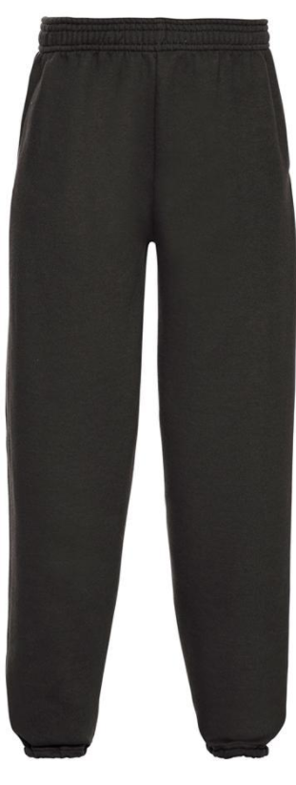
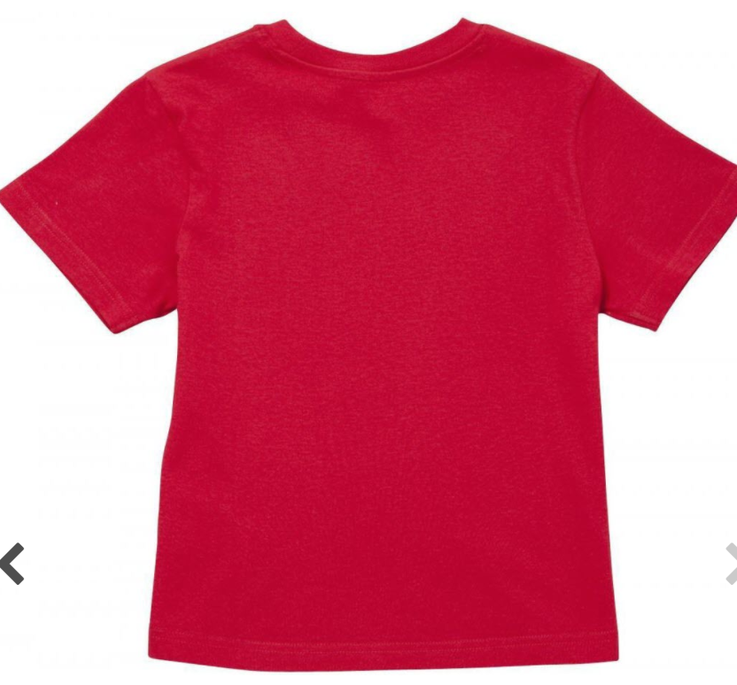

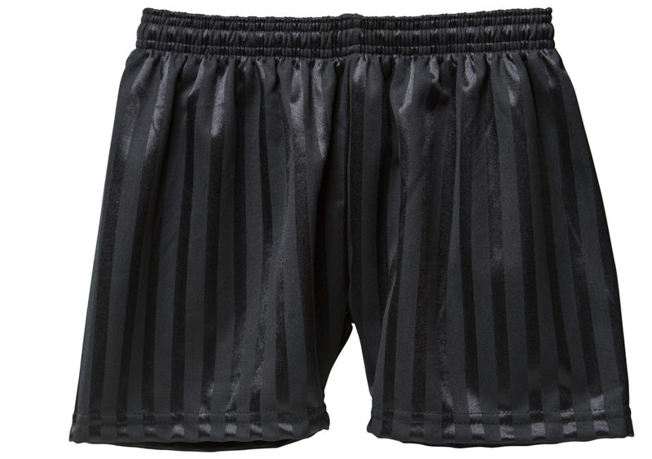
PE Kits:
Indoor:
Outdoor:
r
A red t shirt, black shorts, joggers or leggings and a black sports type hoodie/jacket.
All should be plain and picture free except for the school logo where applicable.

Slide 7
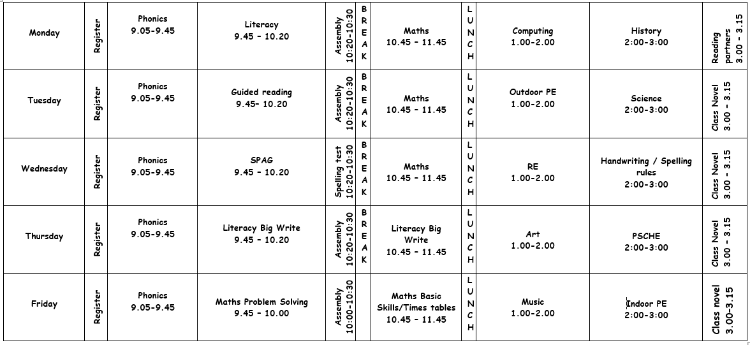
Timetable
r

Slide 8
Autumn Term:
Literacy – Basic skills with a focus on stories based around the Great Fire
of London.
Maths – Basic skills with a focus on place value, addition and subtraction.
Science – Animals including Humans.
PSCHE – Health and well-being: Growing Up
RE – Believing: Who is a Christian and what do they believe?
DT & Art – Drawing
Music – Hands, Feet, Heart – African music
History & Geography – The Great Fire of London.
Computing – Digital Footprint / Being Kind Online
r

Slide 9


Reading at home
Read Write Inc phonetically decodable books
‘Storybook’ + ‘Book bag book’
r

Slide 10
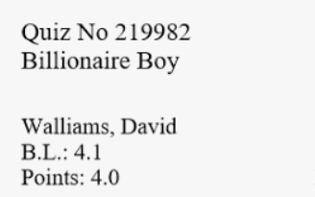

Accelerated Reader
When phonics is secure, children progress to read books on Accelerated Reader.
r

Slide 11
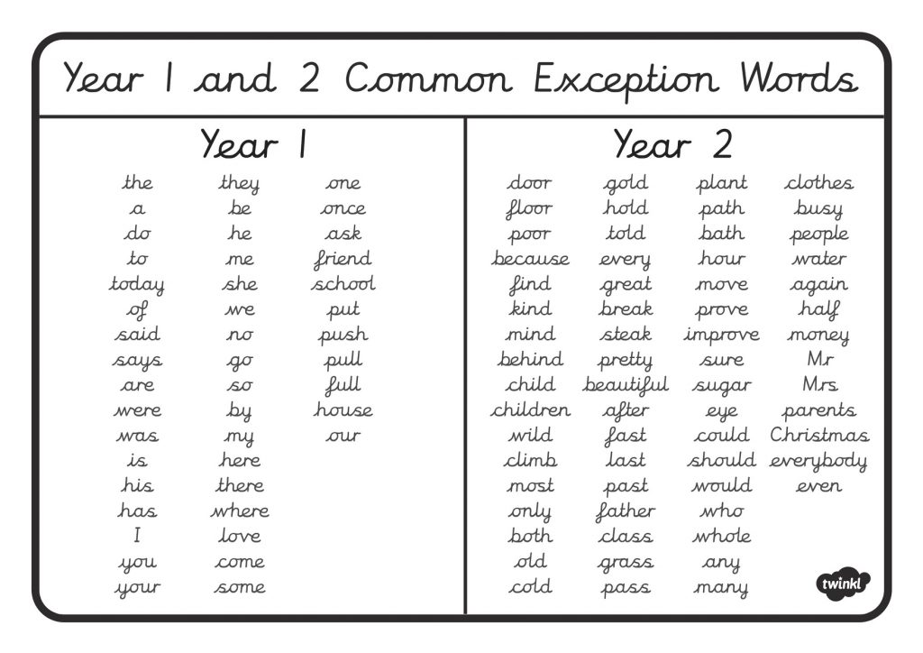
Spellings
r

Slide 12
Homework
Reading – Read as often as possible at home. We suggest reading at least 3 times per week.
Practice spellings – children will learn a new spelling rule per week. Spelling tests take place on a Friday.
r
Timestables – Learn quick recall times tables. TTRS can be used to support with this. Master 2s, 5s and 10s first and then progress onto 3s.
Fortnightly homework – My Maths from September. SPAG.com introduced after Christmas.

Slide 13
Rewards
Sticker cards
Star of the day
House points
Behaviour ladder
r

Slide 14
Thinking ahead…
Year 1 and 2 Concert:
This generally takes place in the first half of the academic year. Generally through a Christmas Nativity.
Class Assembly:
Date TBC.
Year 2 Summer term
Usually plan a trip costing around £20. Advanced notice will be given.
r

Slide 15
Keeping in touch
Our main source of communication is Class Dojo, please check this for any updates and messages.
Please also look at our class page on the school website for reminders of key information.
Email:
abestwick@dovedale.derbyshire.sch.uk
r

