Slide 1
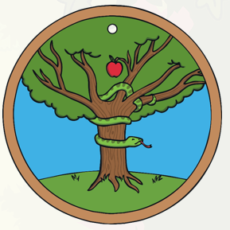
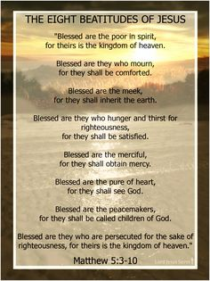

What can we learn from religions about deciding what is right and wrong?
Why are rules important: rules are an important part of our lives because they help people to live safely and take responsibility for their actions.
Religious stories about temptation:
In the bible, Christians learn about the story of Adam and Eve. They lived contentedly in the garden of Eden, with God having told them to not eat any fruit from one tree. One day, a serpent tricked Eve into eating the forbidden fruit which lead to God banishing them from the Garden of Eden.
Christians believe that God wants people to have free will and their own ability to decide to make good decisions and follow His rules.
religion | Golden rule
Christianity | Love your neighbour as yourself.
Judaism | What is hateful to you, do not do to your neighbour.
Humanism | Treat other people as you’d want to be treated in their situation; don’t do things you wouldn’t want to have done to you.
Key vocabulary:
Temptation, parables, commandments, golden rule, beatitudes, Talmud, Siddur
Religion | Teachings that show how to live a good life:
Christianity | Jesus taught that people with certain value or that lived in a particular way would be blessed and live a good life.
Judaism | The Talmud teaches that Jews should say thank you prayers 100 times a day!
 | The siddur prayer book contains lots of ‘blessed are you, King of the universe’ prayers that are said regularly.

Slide 2
What can we learn from religions about deciding what is right and wrong?
Why are rules important: rules are an important part of our lives because they help people to live safely and take responsibility for their actions.
Religious stories about temptation:
In the bible, Christians learn about the story of Adam and Eve. They lived contentedly in the garden of Eden, with God having told them to not eat any fruit from one tree. One day, a serpent tricked Eve into eating the forbidden fruit which lead to God banishing them from the Garden of Eden.
Christians believe that God wants people to have free will and their own ability to decide to make good decisions and follow His rules.
religion | Golden rule
Christianity | Love your neighbour as yourself.
Judaism | What is hateful to you, do not do to your neighbour.
Humanism | Treat other people as you’d want to be treated in their situation; don’t do things you wouldn’t want to have done to you.
REMEMBER: the wording is slightly different for all the religions but are the meanings different?
Key vocabulary:
Temptation, parables, commandments, golden rule, beatitudes, Talmud, Siddur
Religion | Teachings that show how to live a good life:
Christianity | Jesus taught that people with certain value or that lived in a particular way would be blessed and live a good life.
Judaism | The Talmud teaches that Jews should say thank you prayers 100 times a day!
 | The siddur prayer book contains lots of ‘blessed are you, King of the universe’ prayers that are said regularly.

