Slide 1
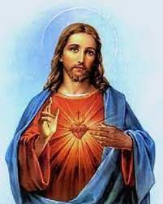
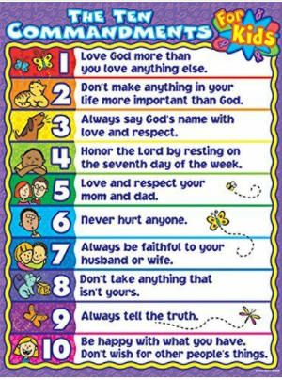
Topic- Why might Jesus being inspiring to some people?
Key Vocabulary | Definition of word
Inspirational | Someone or something that makes you feel hopeful or encouraged.
Values | The traits that people have that help to define us. E.g. Kindness, bravery
Heaven | The spiritual place Christians believe they will go to, to be with God.
Parable | The stories told by Jesus to his disciples to teach them. These stories have a moral or a meaning.
Easter/ Holy week | The time of year in which Christians celebrate the arrival of Jesus into Jerusalem, his betrayal by Judas, arrest, death on the cross and then resurrection. Christians believe that Jesus died to forgive their sins.

Slide 2
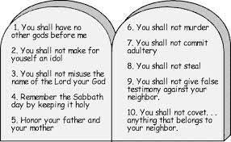
Topic- Why might Jesus being inspiring to some people?
Events of Holy week | What happened? | How they are celebrated today?
Palm Sunday | Jesus rode into Jerusalem on a donkey. Palm leaves were waved and laid on the floor ahead of him. | A church service is held. Palm crosses are used to remember Jesus entry and welcome to Jerusalem.
Maundy Thursday | Jesus ate Passover with his disciples. They prayed together in the garden of Gethsemane. Jesus was arrested. | Church services are held. The Pope traditionally washes and kisses the feet of 12 people, usually members of the church.
Good Friday | Jesus was put on trial and condemned to be crucified. He was beaten, forced to wear a crown of thorns and to carry his own cross. | On good Friday, people traditionally eat hot cross buns to remember Jesus dying on the cross. This is a day spent in reflection remembering Jesus’ death.
Holy Saturday | Jesus was buried in a large tomb with a boulder rolled in front. | This is again spent largely in prayer and remembrance. Churches are traditionally dark to show mourning and respect.
Easter Sunday | Mary went to visit Jesus’ tomb and found it empty. Jesus was Resurrected. | This is a day of celebration. Easter eggs are eaten to represent new life, Church is attended and thanks is given. Candles are lit as a reminder that Jesus is the light of the world.
The Parable of the Mustard Seed:
Big things can come from small acts.
Some Christians may think the ‘word of God’ may seem insignificant, but Jesus said it would have a big impact.
Key Vocabulary | Definition
Inspirational | Someone or something that makes you feel hopeful or encouraged.
Values | The traits that people have that help to define us. E.g. Kindness, bravery
Heaven | The spiritual place Christians believe they will go to, to be with God.
Parable | The stories told by Jesus to his disciples to teach them. These stories have a moral or a meaning.
Easter/ Holy week | The time of year in which Christians celebrate the arrival of Jesus into Jerusalem, his betrayal by Judas, arrest, death on the cross and then resurrection. Christians believe that Jesus died to forgive their sins.
The Ten commandments

