Slide 1
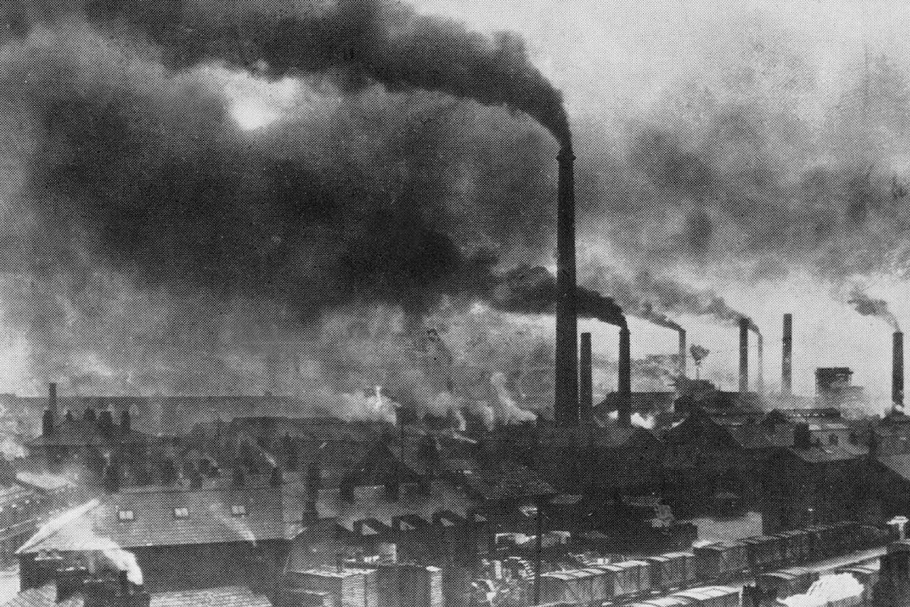
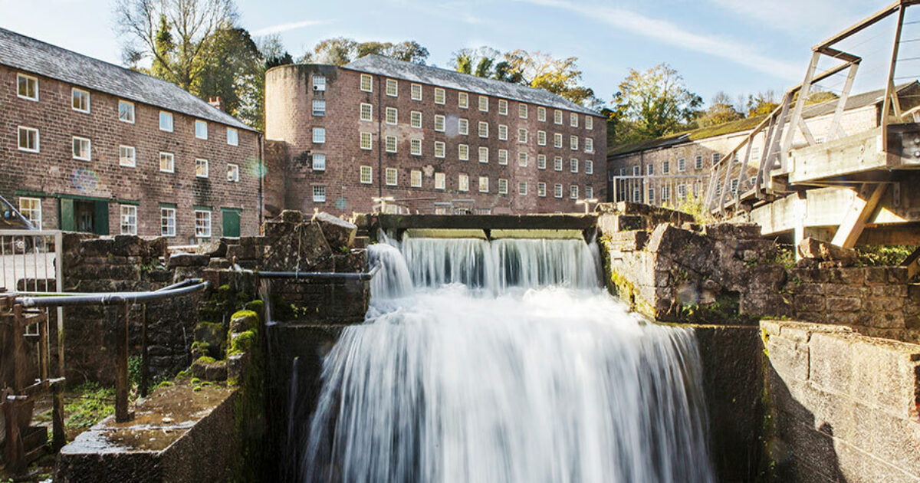
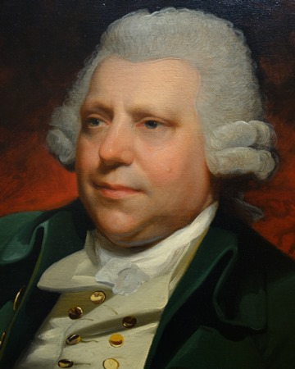
YEAR 6 - KNOWLEDGE ORGANISER FOR THE INDUSTRIAL REVOLUTION - 1760-1840.
WHAT WAS THE INDUSTRIAL REVOLUTION?
Between about 1750-1900 Britain saw great changes in farming, transport and industry. This is called the industrial revolution. Britain was the first country to have an industrial revolution. The population doubled from 9 million to 18 million in the period 1800-1850. This created more workers and more consumers. The development of canals and later the railways meant transport became much quicker. By 1850 there was over 2,000 miles of rail connecting London to other major centres in England.
Cromford Mill today.
GREAT BRITISH INVENTORS.
Alexander Graham Bell: Invented the Telephone in 1876.
George Stephenson:Invented locomotion which led to steam engine trains. 1712.
Isambard Kingdom Brunel — Used steel to create bridges and railway lines.
Michael Faraday: Invented the electric generator and the Bunsen burner. 1855
James Hargreaves: Invented the Spinning Jenny in 1764.
KEY VOCABULARY:
Agriculture — Farming e.g. growing crops.
Child Labour —The employment of children in industry/work.
Invention —The process of creating something new.
Population —The people who live in a particular place.
Reform —Making changes in order to improve something.
Poverty - The lack of basic human requirements like clean water, nutrition, healthcare, education and shelter.
Urbanisation —When people moved to towns / cities.
Richard Arkwright.
Richard Arkwright (1732—1792)
Named the ‘Father of the factory’ He created a cotton spinning machine that sped up production and also a water frame that powered machinery. He built his first factory in 1771 and mass produced cotton - never been seen before! King George III Knighted Arkwright. Although his factories employed children as young as 6 years old he is often credited as being the man who started the Industrial Revolution

